Slide 1

SUPERMARKET PERFORMANCE ANALYSIS
Data-Driven Recommendations for Profitability & Operations
IITM Online BS Degree Program, Indian Institute of Technology, Madras, Chennai Tamil Nadu, India, 600036
Presenter : Deepanshu Singh
Roll no. : 23f3000048

Slide 2
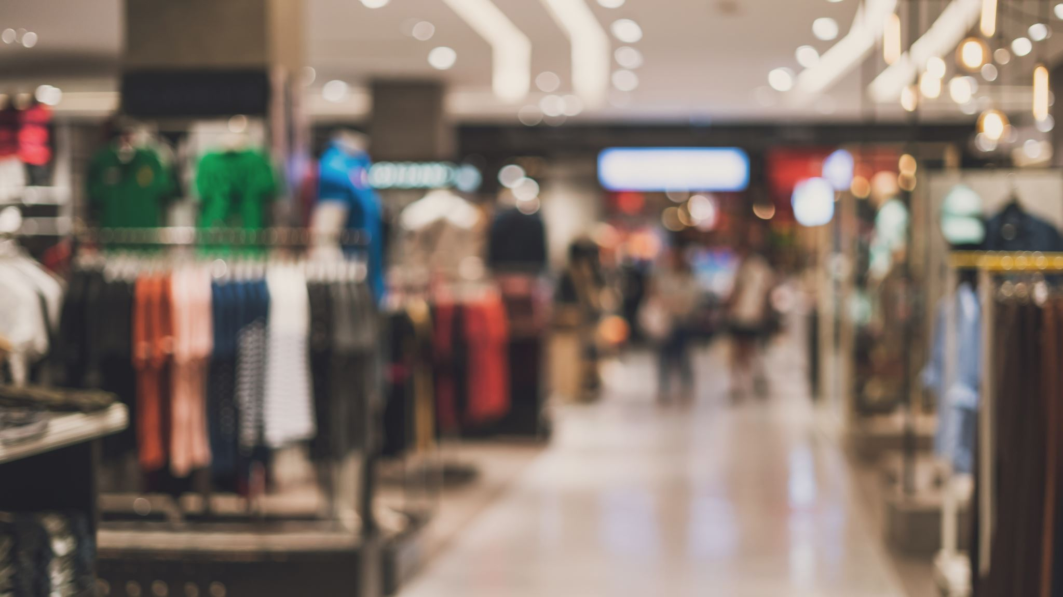
Business Context
ABOUT MYANMAR SUPERMARKET GROUP
• 3 branches: Yangon A, Yangon B, Naypyidaw
• 6 product categories: Food & beverages, Sports & travel, Electronics, Fashion, Health & beauty, Home & garden
• 1,000 transactions analyzed (3 months)
• Key metrics: Sales, Gross income, Customer rating, Customer type (Normal vs Member)
BUSINESS CHALLENGE:
How to grow profitability while maintaining service quality
during peak hours ?

Slide 3
Problem Statement & Objectives
THREE BUSINESS PROBLEMS TO SOLVE:
1. Category Profitability
Problem: Which product categories drive profit? How
should we allocate inventory and shelf space?
2. Operational Efficiency
Problem: When is demand highest? How should we
staff and manage checkout during peak times?
3. Customer Loyalty
Problem: How do Members differ from Normal customers?
Should we prioritize loyalty conversion?
PROJECT OBJECTIVES:
→ Identify high-profit categories
→ Optimize staff allocation by hour
→ Design loyalty conversion strategy

Slide 4
Data Overview
DATA QUALITY & STRUCTURE
Dataset: SuperMarket-Analysis.csv
1,000 transactions (100% complete, zero missing values)
16 features: Invoice ID, Branch, Date, Time, Customer type, Gender, Product line, Unit price, Quantity, Tax, Sales, COGS, Gross income, Payment method, Rating
DATA CLEANING:
Verified financial identity: Sales = (Unit Price × Quantity) × (1 + Tax%)
No outliers or invalid entries
Date range: 3 months of balanced daily transactions
Rating scale: 1–10 (no anomalies)
FEATURE ENGINEERING:
Hour extracted from Time (e.g., 13:08 → Hour 13)
Weekday extracted from Date (Monday–Sunday)
Customer segments created (Normal vs Member)

Slide 5

Analysis Methods
APPROACH & TECHNIQUES USED
1. DESCRIPTIVE ANALYSIS
• Group-by aggregation: category revenue, hourly sales,
customer AOV
• Ranking: sorted categories by profit to identify
top performers
• Statistical measures: mean, sum, count
2. SEGMENTATION
• By Product line (6 categories)
• By Hour (10–21, peak at 19:00)
• By Customer type (Normal vs Member)
3. KEY METRICS
• Revenue (Sales) = ∑ invoice sales by category/hour
• Gross Income = ∑ profit by category/hour
• Average Order Value (AOV) = avg sales per transaction
• Rating = avg customer satisfaction by hour

Slide 6
Key Findings — Executive Summary
FINDINGS AT A GLANCE
Top 3 categories (Food & beverages, Sports & travel,
Electronics) contribute 51% of total revenue
Peak hour is 19:00 → 12% of daily revenue in 1 hour
BUT customer rating drops from 7.0 to 6.7 at peak
Members spend 29 more per transaction than Normal
customers (Member AOV = 335.74 vs Normal = 306.37)
Health & beauty category is underperforming in profit
despite decent sales → needs intervention
Evening (18:00–21:00) consistently shows higher stress
(queue, lower ratings) → staffing is critical

Slide 7

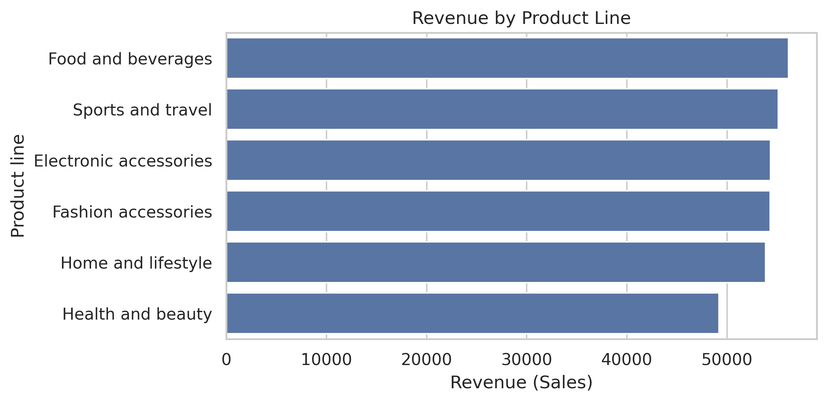
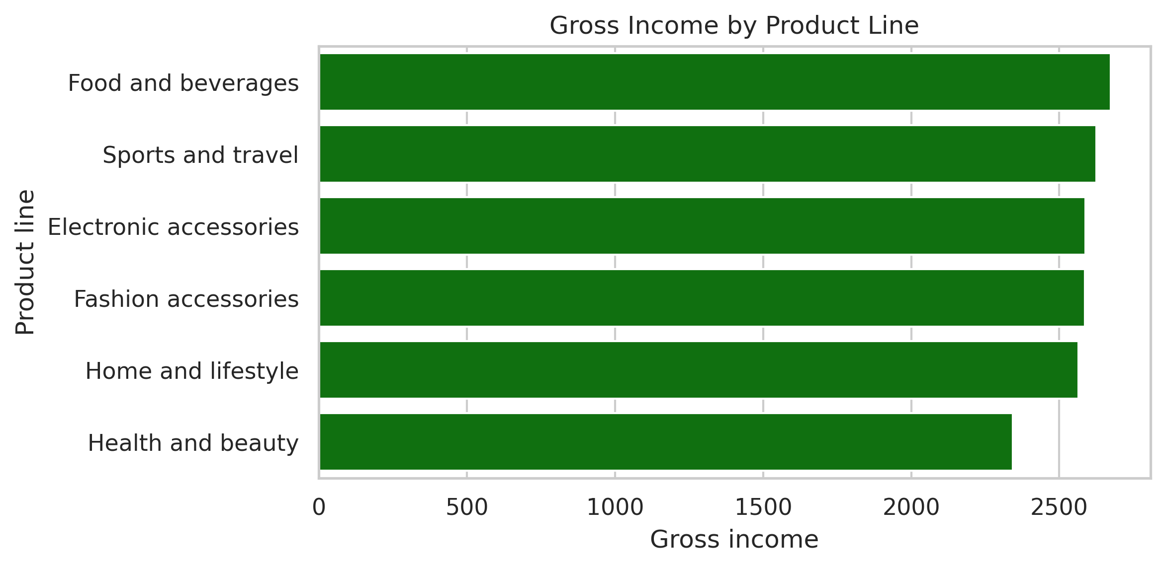
Category Profitability Analysis
FINDING 1: WHICH CATEGORIES DRIVE PROFIT?
Top performers (by revenue & gross income):
1. Food & beverages: 56,144 revenue, highest GI
2. Sports & travel: 55,122 revenue, stable GI
3. Electronics: 54,337 revenue, good margins
Underperformers:
• Health & beauty: Only 49,193 revenue, lowest GI
• Home & garden: 52,641 revenue, inconsistent GI
IMPLICATION:
Top 3 categories are the bread-and-butter. Health & beauty
needs product mix review or pricing strategy change.

Slide 8
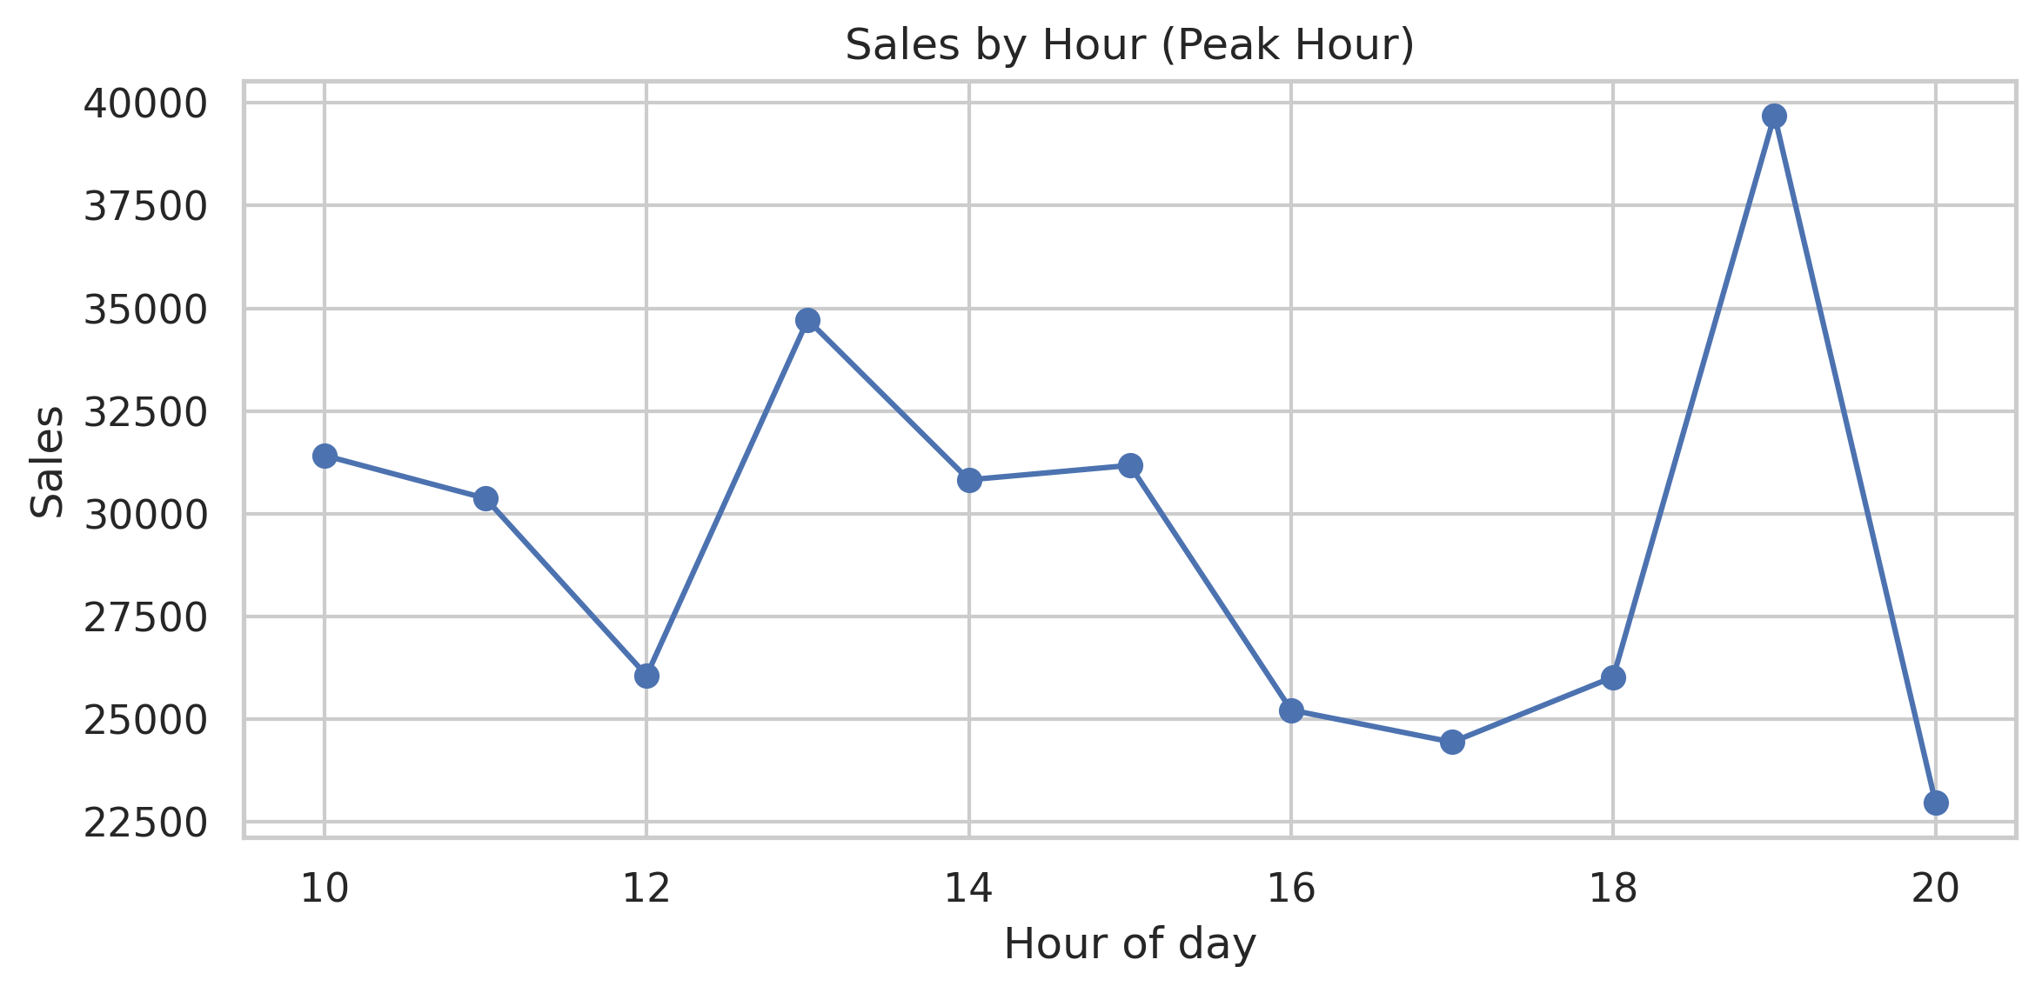
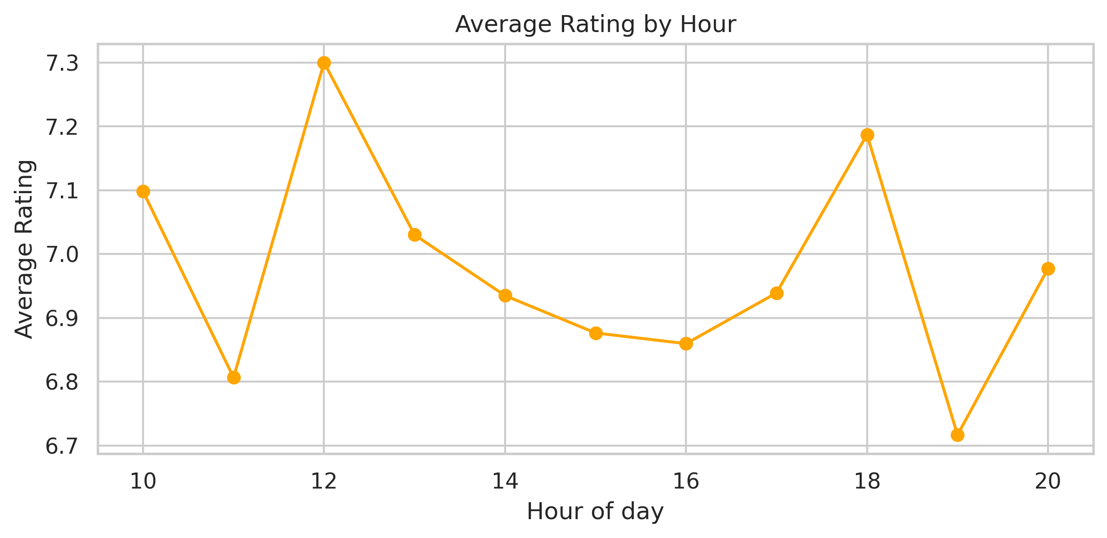
Operational Efficiency — Peak Hour Analysis
FINDING 2: WHEN IS DEMAND HIGHEST?
HOW SHOULD WE STAFF?
Peak Hour Insight:
• Sales are flat until 18:00, then spike at 19:00
• 19:00 hour = 12% of total daily revenue (highest 1-hour
window)
• After 20:00, sales drop again
SERVICE QUALITY STRESS:
• Customer rating drops from 7.2 (morning) to 6.7 at 19:00
• Indicates: long queues, slow checkout, staff overload
DECISION:
Extra staff (2 cashiers) should be scheduled for 18:00–20:00
only, not all day. This saves labor cost and focuses effort
where it matters.

Slide 9
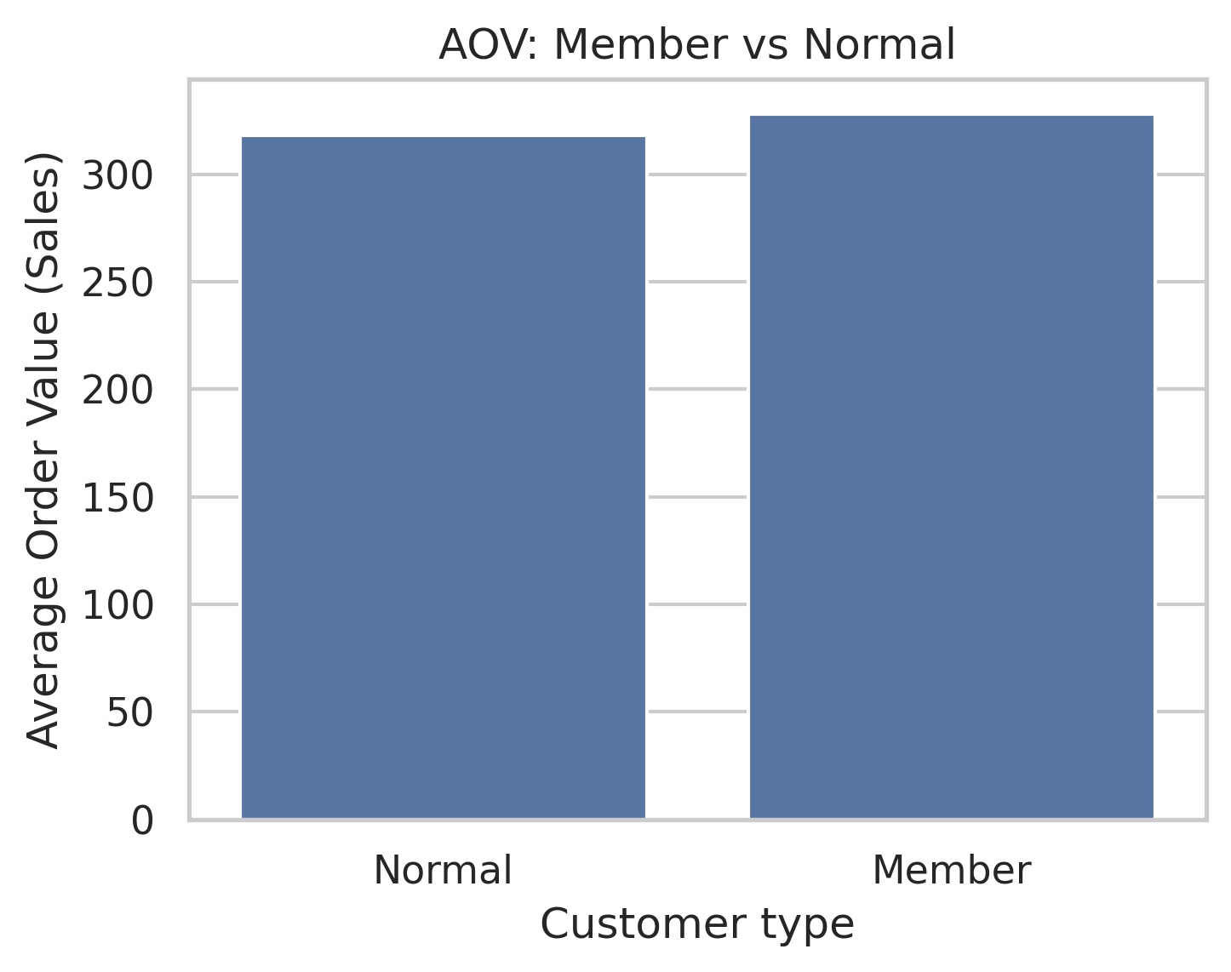
Loyalty & Customer Segmentation
FINDING 3: MEMBER vs NORMAL CUSTOMER VALUE
AOV Comparison:
• Member AOV: 335.74 (average order value)
• Normal AOV: 306.37
• Gap: +29 per Member transaction (9.5% higher)
LIFETIME VALUE IMPLICATION:
If a customer shops 10 times/month:
• Normal: 306.37 × 10 = 3,063.70
• Member: 335.74 × 10 = 3,357.40
• Difference: +294 per month
RECOMMENDATION:
Convert Normal customers to Members via:
✓ New member discount (10% off first purchase)
✓ Loyalty points (1 point = 1 rupee)
✓ Member-only promotions on top categories
✓ Target: Convert 20% of Normals in 6 months

Slide 10
Recommendations & Success Metrics
ACTIONABLE RECOMMENDATIONS WITH KPI TARGETS
RECOMMENDATION 1: Category Assortment & Inventory
Action: Protect top-3 categories with +15% shelf space & stock
Metric: Top-3 category GI: 2,695 → 3,100 (target +15%)
Timeline: 1 month
RECOMMENDATION 2: Peak-Hour Operations
Action: Add 2 cashiers + 1 express lane (QR checkout) 18:00–20:00
Metric: Rating at 19:00: 6.7 → 8.0 (target 8+)
Timeline: 2 weeks
RECOMMENDATION 3: Loyalty Conversion
Action: Launch "New Member" offer (10% first purchase)
+ tier rewards (Silver/Gold)
Metric: Normal→Member conversion: 0% → 20% (target in 6 months)
Timeline: Immediate rollout
SUCCESS FRAMEWORK:
✓ All recommendations are data-backed

Slide 11




Thank You

